Slide 1
Full-time, u.s. based, Data Science Salaries from 2020-2023
Joshlyn Jamerson
​

Slide 2
Stakeholder Interest
Fair compensation
Negotiating power
Career planning
Transparency and equity
Notes:
Understanding the threshold for fair compensation is super important. It allows employers to know what is a fair wage to offer to people. This information can ensure they are being fairly compensated for their skills, experience, and contributions.
Wage information also allows those in search of a job to know what to expect.
This data can help individuals make informed decisions about career paths, job changes, and skill development to maximize their earning potential.
Access to salary information promotes transparency within organizations and across industries.

Slide 3
Agenda
Highest Paid Jobs
Lowest Paid Jobs
Most Popular Jobs and their Average Pay
How does experience level relate to pay
Remote work
Ratio to company size

Slide 4
DATA CLEANING
Removed Data From Other Countries
Full Time Employee Data Only
Notes:
This dataset contained information about companies that were not located in the U.S. For the purpose of my analysis, I excluded those and only focused on U.S. based companies.
This dataset also contained information about multiple types of employees. I removed all data that was not related to full time employees.

Slide 5
COLUMNS OF INTEREST
Job Title
Salary in USD
Employment Type
Company Location
Remote Ratio
Company Size

Slide 6
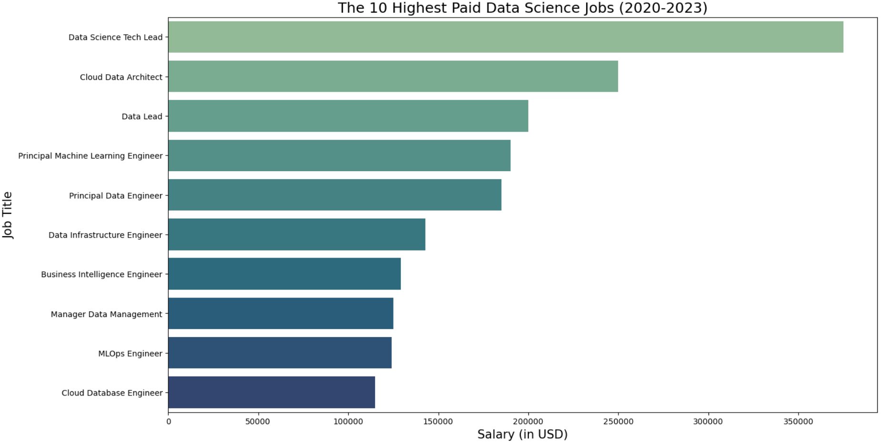

Slide 7
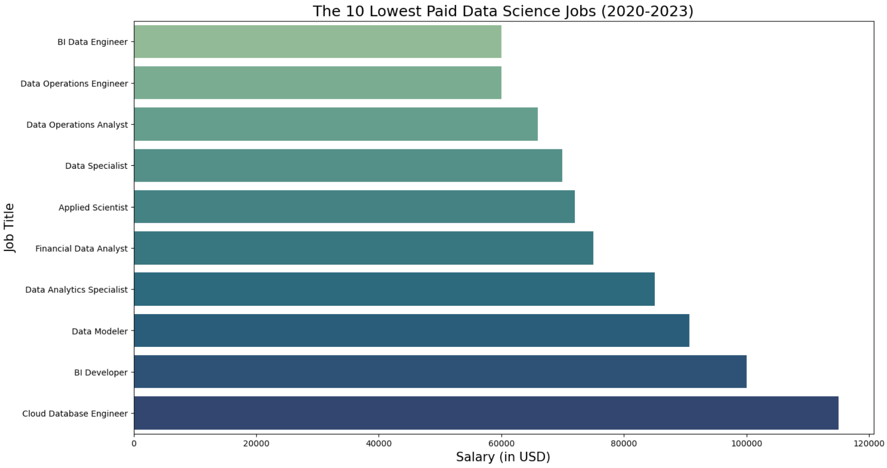

Slide 8
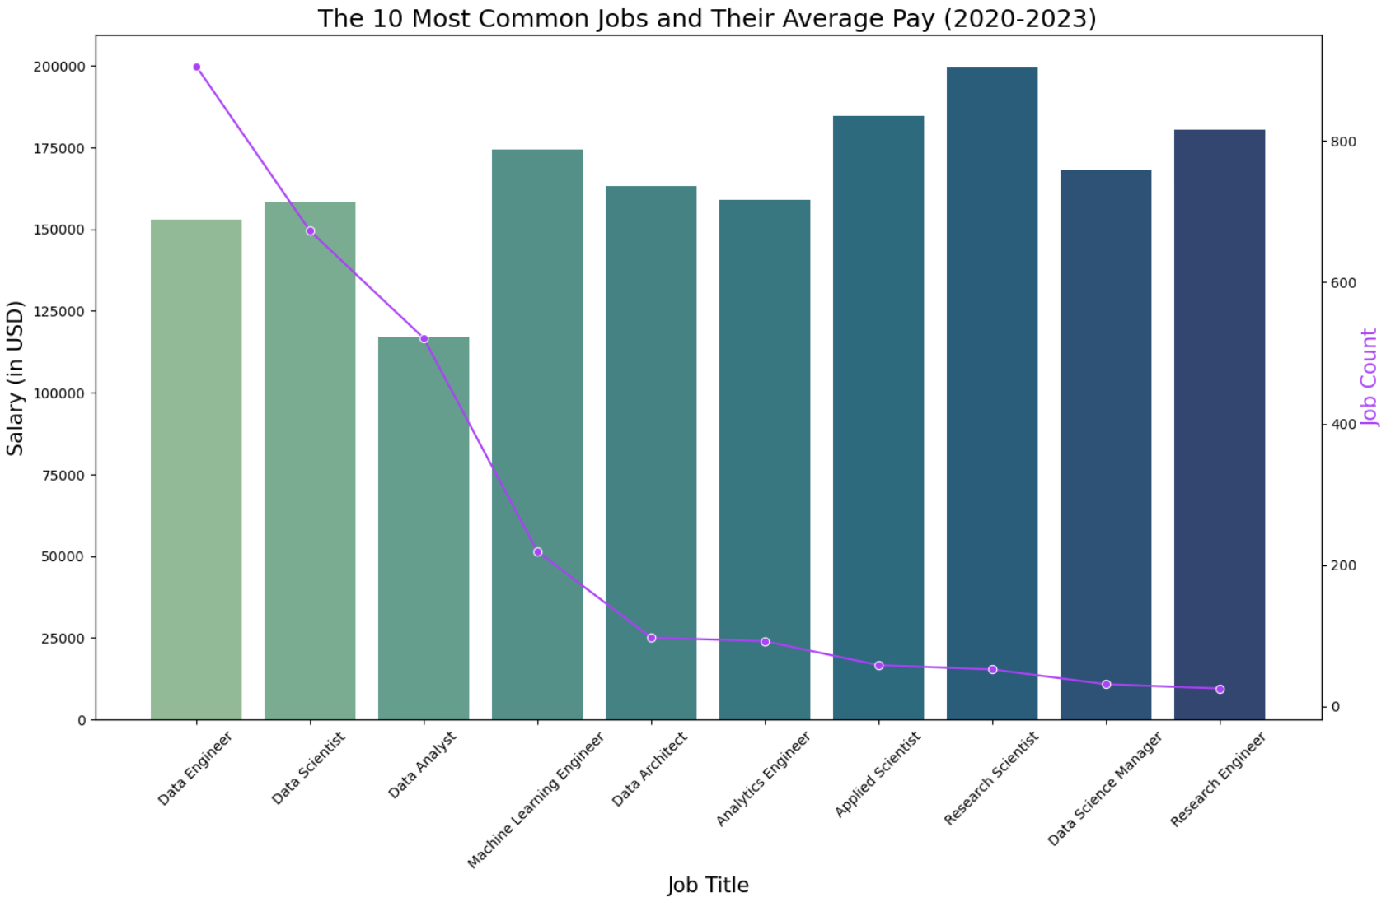

Slide 9
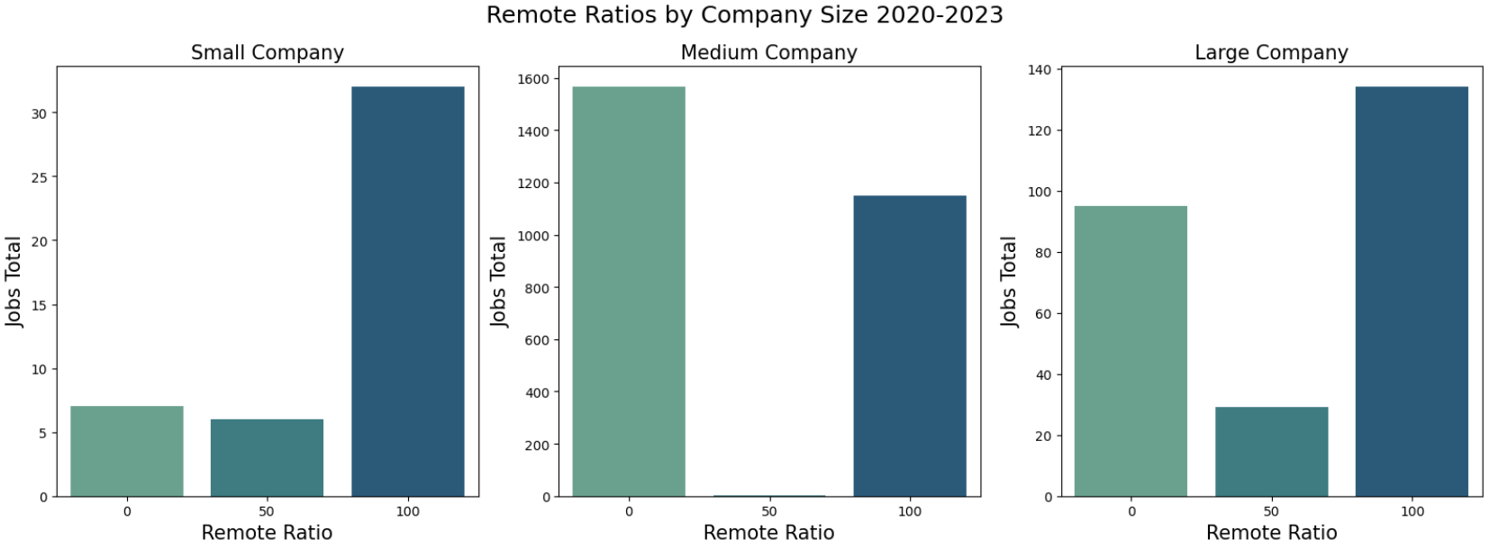
Notes:
In terms of company sizes, small company is defined as a company with 500 employees or less
Medium Company is defined as companies with 500-1000 employees.
Large companies is defined as companies with 1000+ employees.

Slide 10
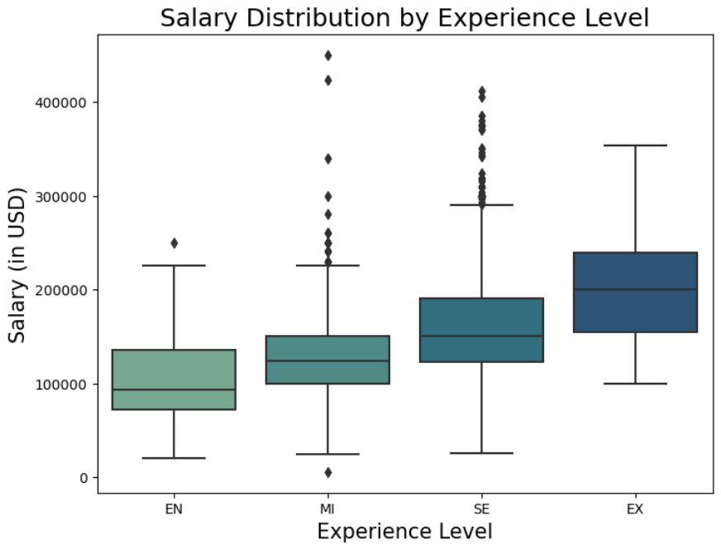

Slide 11
Future project plans
Analysis on companies located outside of the U.S
Analysis on part-time, contract, and freelance salaries

Slide 12
Q&a/Contact info
Joshlyn Jamerson
Joshlyn.Jamerson@spaceforce.mil
Original dataset: https://www.kaggle.com/datasets/arnabchaki/data-science-salaries-2023
Github Repository: https://github.com/joshlynj/ds_salaries

Slide 13
text
text
text

Slide 14
text
text

